Slide 2
Help Us
Control Costs
Help You
Save Money
Adapted from UVa Libraries

Slide 3
Controlling journal costs
Three powerful forces are driving up the cost of managing research and disseminating research results.
First: basic economics of publishing and disseminating the results of research.
Second: Horizontal integration – consolidation– in the industry that publishes the results of research.
Third: Vertical integration – publishers have begun to buy or develop most of the tools faculty use for managing their research process

Slide 4
The basic economics of publishing lead to high costs for the academy.

Slide 5
Dysfunction in publishing
Universities, governments, and grant funders pay three times to disseminate research results:
We pay faculty authors to conduct research and draft papers, which faculty members transfer gratis to publishers
We pay faculty editors who volunteer their time to peer-review and edit journal submissions
We pay publishers (subscription costs and Article Processing Charges (APCs)) for access to the final, published articles…
…Upon which career advancement for faculty authors and editors depend
Adapted from B. Butler & J. Unsworth, Research Information Costs at the University of Virginia, 2018

Slide 6
The Result: HUGE profit margins
Pharmaceuticals (Pfizer): 42%
RELIX (Elsevier): 39%
Apple: 37%
Taylor & Francis: 36%
Springer-Nature: 35%
Banking (Industrial & Commercial Bank of China): 29%
Wiley: 28%
Automotive (Hyundai): 10%
Adapted from B. Butler & J. Unsworth, Research Information Costs at the University of Virginia, 2018

Slide 7
Horizontal integration in the publishing industry

Slide 8
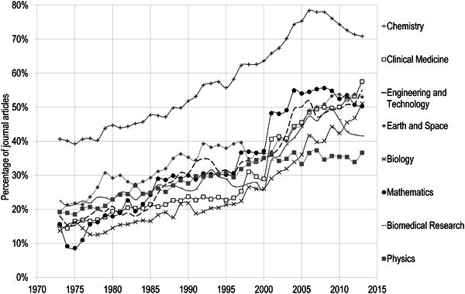
Fig 3. Percentage of papers published by the five major publishers, by discipline in the Natural and Medical Sciences, 1973–2015.
Larivière V, Haustein S, Mongeon P (2015) The Oligopoly of Academic Publishers in the Digital Era. PLOS ONE 10(6): e0127502. https://doi.org/10.1371/journal.pone.0127502
https://journals.plos.org/plosone/article?id=10.1371/journal.pone.0127502
Notes:
Increasingly, a handful of publishers dominate the science disciplines.

Slide 9
Vertical integration: companies seek additional revenue streams from the research ecosystem by selling powerful tools for research management

Slide 10
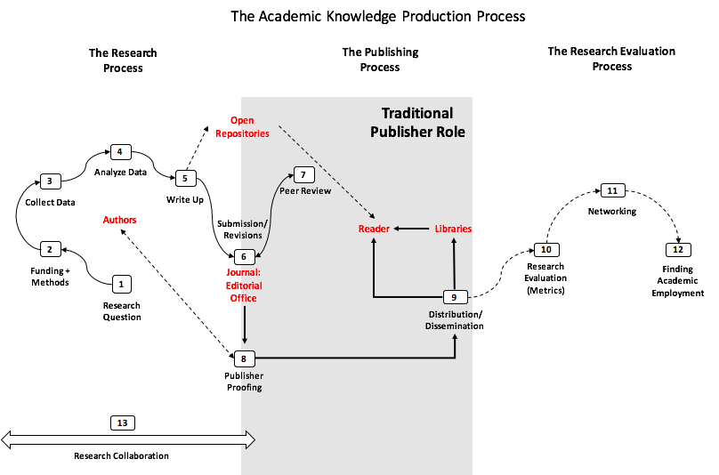
Image from knowledgegap.org
Notes:
- Traditionally, publishers managed the dissemination of research results. The tools that researchers use for their work wasn’t part of their product offerings.

Slide 11
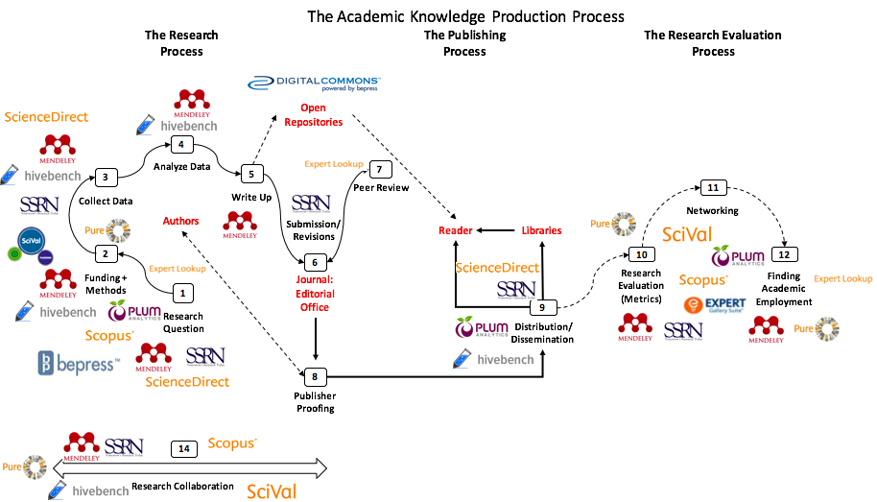
ALL owned by Elsevier!
Image from knowledgegap.org
Notes:
Now, publishers have expanded far beyond their traditional role. The sell products for virtually every part of the research ecosystem.
Essentially, commercial publishers now seek to extract profit from every part of the work we do in universities.

Slide 12
Elsevier contract agreement with Virginia Research Libraries Group
September 2016
Contract renegotiation Dec. 2016
Notes:
- This was the Virginia consortium’s counter-proposal, which Elsevier accepted.
- Total spend by Virginia during the 5 year contract: $45,470,200.
- Our negotiations saved Virginia $1,287,539 … only about 2.75% less than the original Elsevier contract.

Slide 13
Elsevier VRLG contract agreement September 2016, VCU costs
Contract renegotiation Dec. 2016
Notes:
This is the cost to VCU for the renewed Elsevier package.
Total spend by VCU for this package during the 5 year contract: $9,274,113

Slide 14
What we purchase in a typical scientific journal subscription
Journal “X” publishing run: what a subscription buys
Backfiles and early years; often already owned by library and available in perpetuity
Recent years; estimated 45% of recent articles compliant with Fed open access mandate and available free of charge; 28% of articles overall
Current year -- paywalled, subscription access only
+
in some cases, open access funded by APCs, about 7% of articles
Notes:
When we buy a subscription, we pay for access to a title. But in many cases, we already own the previous issues of a journal, and often, a significant amount of journal content is available free of charge after one year due to Federal mandates for open access to Federally-funded research.
That means often, we’re paying a high price for basically just the current year, and some of that is already funded by our universities through Article Process Charges.
Backfiles: generally around 60% of core Elsevier journals
Open access: around 45% of recent articles (past 5 years), 28% of all articles overall
Current year: around 7% published as open access via APCs
So a subscription price often is paying for 93% of the current year articles only – a very high cost.

Slide 15
Short-term challenge: Information Asymmetry
The primary consumers of these products, YOU, faculty members and researchers, don’t pay directly for these resources and have no sense of what they cost, and don’t know the tradeoffs and sacrifices involved in acquiring any particular subscription.
The primary purchaser, the VCU Libraries, has only imperfect information about how journals are used, which ones are most valuable to researchers, and which trade-offs would be acceptable to users in making the best decisions about a subscription.
This leaves VCU’s libraries without alternatives to publisher proposals about the how much we should pay for journal subscriptions. We end up using publisher “cost-per-use” data, and publisher conclusions that connect journal use to researcher value – the worst possible pricing mechanism.
Adapted from UVa Libraries

Slide 16
Addressing the challenge of information asymmetry
The users of journals (YOU) need more information about costs and trade-offs about journals, so you can understand (and support) hard choices.
VCU Libraries needs more information about how campus communities (YOU) value and use these resources…and better tools to ascertain and evaluate actual use and usefulness.
With this kind of information exchange, we can make the right (and hard) choices in negotiations, even if it means canceling some subscriptions.
University of California, German universities, the French, many others are using these new approaches to reign in the punishing costs of journal subscriptions.
Adapted from UVa Libraries

Slide 17
What we need you to do
Help us determine the value of journals and journal subscriptions, and help us share the cost and value information we develop
Enlist your colleagues, your chairs, and others to point faculty members to VCU Libraries web pages and VCU librarians about these issues
Work with us to develop mechanisms to get input from faculty, so that our decisions are informed as much by faculty perspective as they are by our data
Help us promote and evaluate ways to acquire journal articles even if VCU doesn’t have a subscription
Adapted from UVa Libraries

Slide 18
Our commitment to you
We will better understand journal value and costs with newly-developed and powerful tools, so that we use information that comes from our community, not publishers.
We will strengthen our collaboration with other research universities in Virginia to present a united front and create a stronger bargaining position
We will reduce cost increases so that VCU can redirect funds from annual journal cost increases to faculty positions and faculty salaries
We will always get you journal articles and other scholarly materials you need to do your work. Period. Full stop.
Adapted from UVa Libraries

Slide 19
Source: UC System

Slide 20
Some examples
VCU Libraries cost disclosure page: https://www.library.vcu.edu/research/collections/sustainable-collections/
Find open-access versions of journal articles with unpaywall and Open Access Button: https://www.library.vcu.edu/research/tools/
UC System’s “Challenges to Licensing with Some Publishers”: http://www.cdlib.org/services/collections/current/challenges.html
Ithaka S/R Report: “Red Light, Green Light” - on evaluating Library investments, and making those evaluations transparent and useful to campus communities - https://doi.org/10.18665/sr.304419

Slide 21
Some guidance
Open Access Guide:
https://guides.library.vcu.edu/open-access/overview
“Predatory publishers”:
https://guides.library.vcu.edu/open-access/preparing
Manage your data:
https://www.library.vcu.edu/services/research-support/data/
Information on copyright: https://www.library.vcu.edu/services/research-support/copyright/
VCU Libraries cost disclosure page: https://www.library.vcu.edu/research/collections/sustainable-collections/

Slide 22
Notes:
There is also something that we as librarians need to do: keep in mind that we’re not alone!
So far in 2019, there have been 9 institutions that have cancelled their bundled Big Deal subscriptions
Elsevier is on our minds because it has the highest profit margins, the highest cost to us, and an upcoming renewal date in 2021.
But as you can see from this chart, Elsevier is not the only one we need to target.

Slide 23
Footnote:
The University of California decision about Elsevier
Journal “X” publishing run: what a subscription buys
Backfiles and early years; often already owned by library and available in perpetuity
Recent years; estimated 45% of articles compliant with Fed open access mandate and available free of charge
Current year -- paywalled, subscription access only
+
in some cases, open access funded by APCs
UC sought to negotiate total state spend – subscription $ plus APC $ -- to recognize other UC contributions as editors and readers.
Notes:
The University of California sought to negotiate a price for journals that took into account the fact that faculty were already paying for open access with APCs…and previous content had already been paid for.
We also have recent evidence that suggests open access is better for the visibility and impact of scholarship:
- A recent analysis of our journal subscriptions indicates that articles published by VCU authors as open-access – either in open access journals or by paying APCs – are cited by others in their field, on average, at twice the rate of paywalled articles. In some disciplines, the citation rate for open-access articles is as much as 10 times higher for VCU authors.
The same data set indicates that the average impact factor from OA papers is about 15% higher than paywalled papers.
And on top of that, about 59% of papers published by VCU authors from 2008 through 2017 at OA, compared to about 37% of all papers worldwide.

