Slide 1
Office of the Vice President for Health Sciences
Faculty Senate Update
October 3, 2017

Slide 2
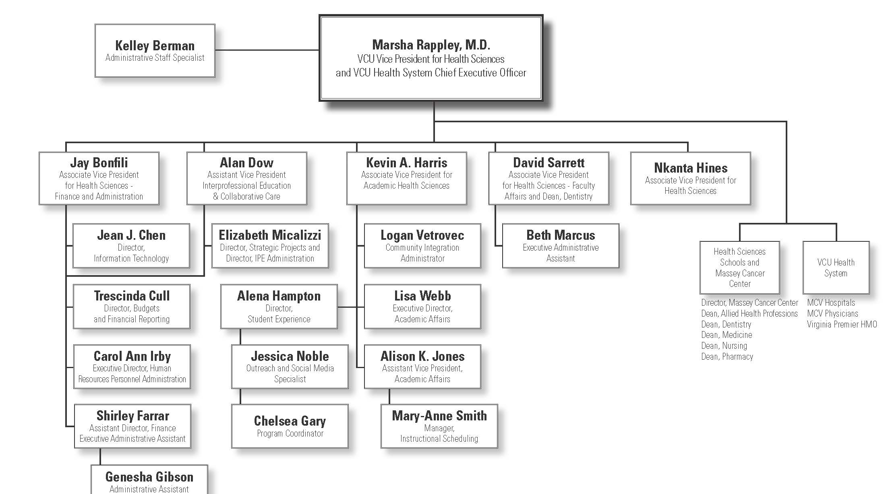
Office of the Vice President for Health Sciences Organizational Chart
Tedra Baskerville
Business Operations Analyst

Slide 3
Key Initiatives and Collaborations
Key Initiatives
Vision by Design
Health Equity Initiative
P&T Review System
Policy on Endowed Professorship/Chairs
Opiate Epidemic – Education and Practice Alignment
Key Collaborations
Provosts Office
Academic Affairs
Faculty Affairs
University Planning Efforts
New Budget Model
HR Redesign
iCubed

